Slide 1
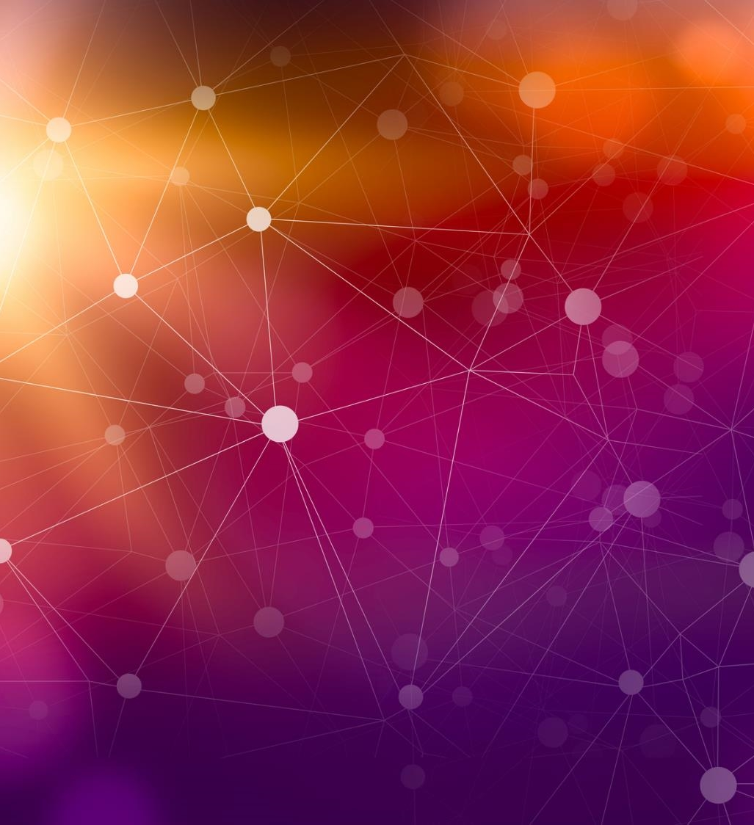

Student Information
Student Information
Artificial Intelligence
Course code: CSE 316
Course Section: 221_D7
Teachers’ Name: Md. Sabbir Hosen Mamun
Name | Id
Md. Jahid Hasan Jitu | 221002248
Md. Rana Miah | 221002217

Slide 2
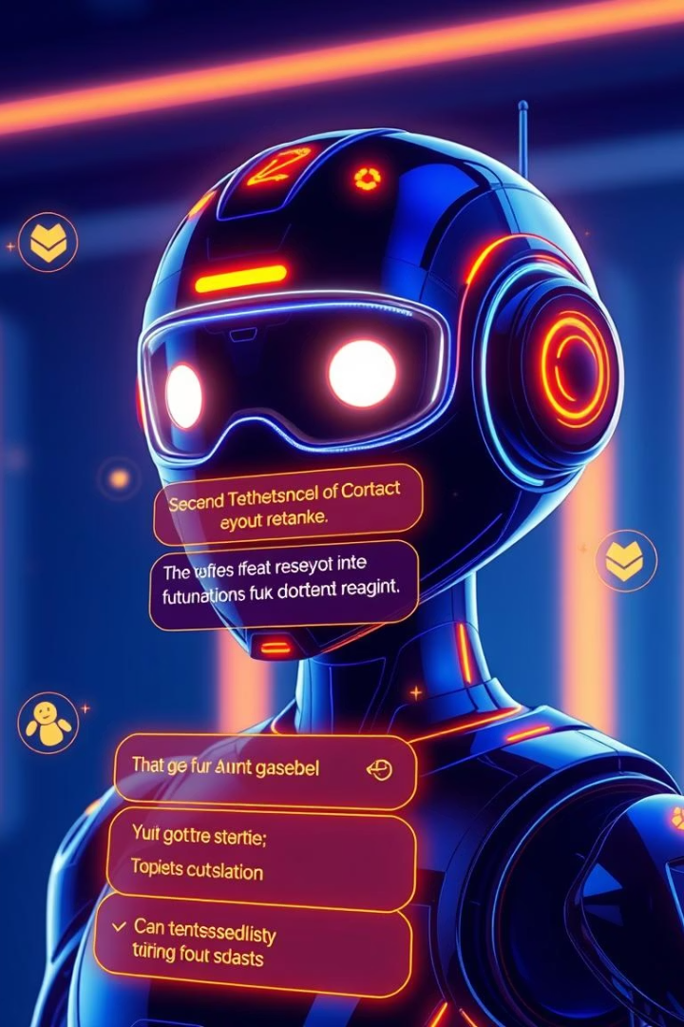
AI Chatbot, “GuBot”

Slide 3
TABLE OF CONTENT
Project Overview
Chatbot Features
Development Tools
Development Process
Backend Architecture
Frontend Implementation
Benefits of Chatbots
Future Enhancements
Conclusion

Slide 4
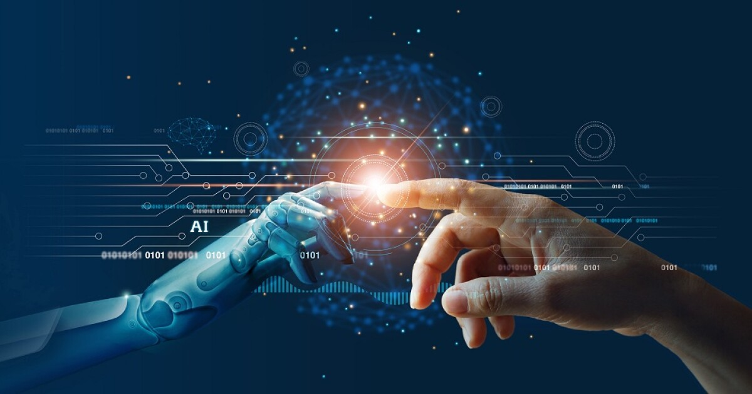
Project Overview
The project main goal is divided in two categories-
. Goal
Develop a chatbot to enhance customer service.
. Target Audience
Customers seeking support and information.

Slide 5
Chatbot Features
Chatbot
Natural Language Processing
Knowledge Base
Personalized Responses
Access to a chatbot model of information
Trailered interaction with user.
Understand and respond to user queries.

Slide 6
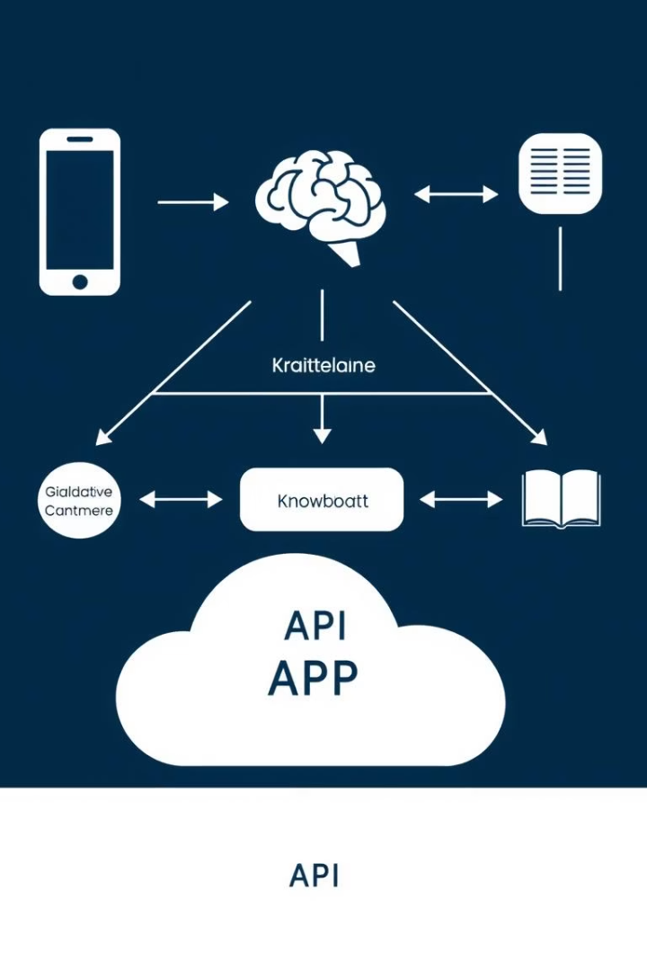
Development Tools
Programming Language: Python, JavaScript (Frontend)
Frameworks/Libraries: TensorFlow/Keras.
NLP Tools: Tokenization, Lemmatization
Data Format: JSON for storing intents
User Interface: GUI(HTML/CSS)

Slide 7
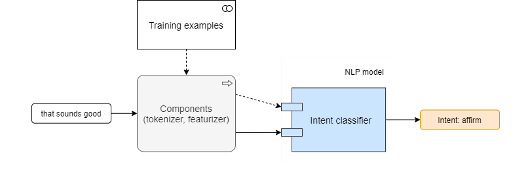
Development Process
What We Built:
A web-based AI chatbot using NLP and deep learning
Key functionalities:
Intent recognition
Dynamic responses (greetings, FAQs, jokes)
User-friendly interface

Slide 8



Training and Evaluation
Data Collection
1
Gather user interactions and feedback.
Model Training
2
Improve chatbot's accuracy and performance.
Performance Evaluation
3
Measure chatbot's effectiveness and identify areas for improvement.

Slide 9
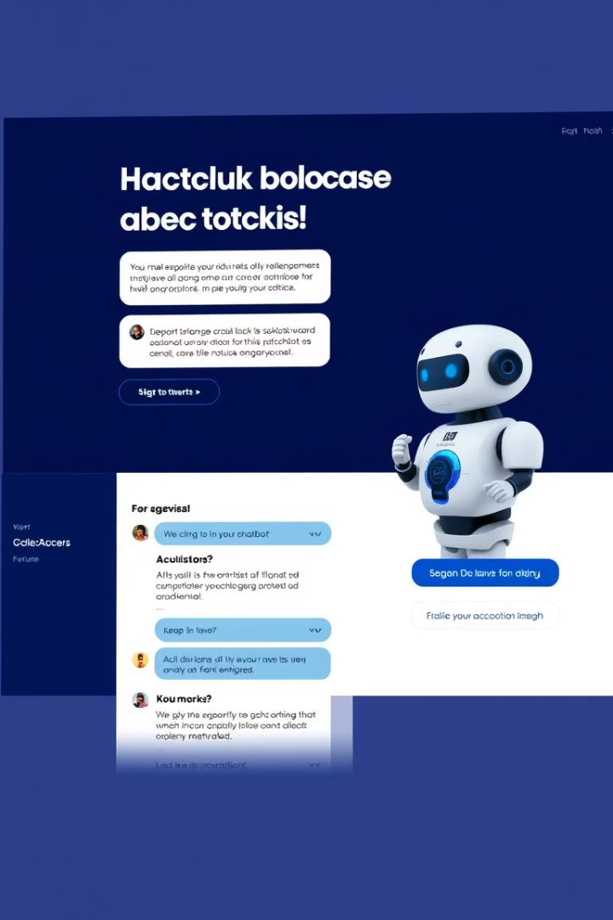
Integration and Deployment
Website Integration
Embed the chatbot into the website.
API Connections
Connect the chatbot to external systems.
Deployment and Monitoring
Launch the chatbot and track its performance.

Slide 10
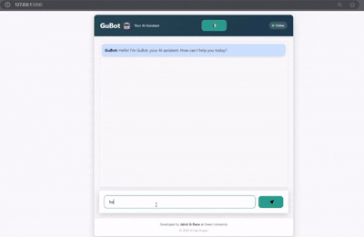
GuBot Test Output
Here is the project output,
Tested with 50+ varied inputs (greetings, questions, edge cases)
"For out-of-scope inputs (e.g., 'asdfg'), the chatbot returns graceful fallback responses like 'I'm still learning. Can you rephrase that?' instead of technical errors."

Slide 11
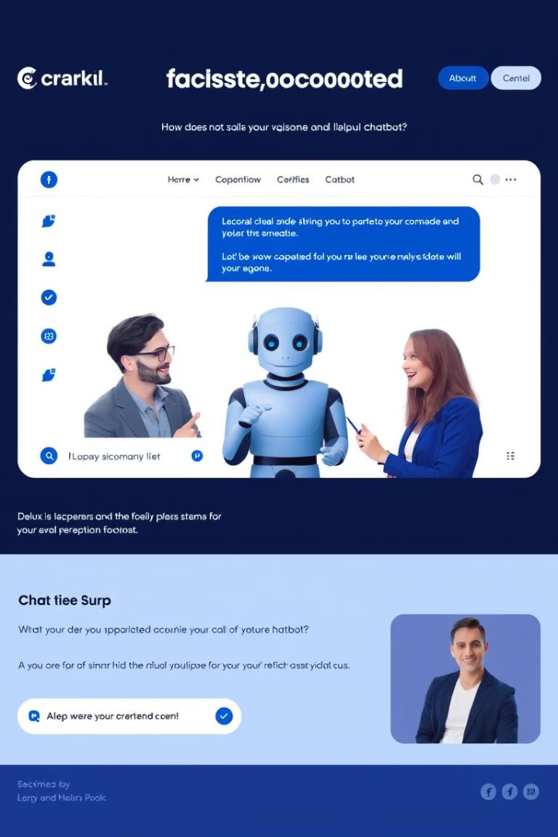
Benefits of Chatbots
Improved Customer Service
Increased Efficiency
Automate repetitive tasks and free up human agents.
Faster response times and 24/7 availability.
Enhanced Customer Satisfaction
Personalized interactions and improved resolution rates.

Slide 12
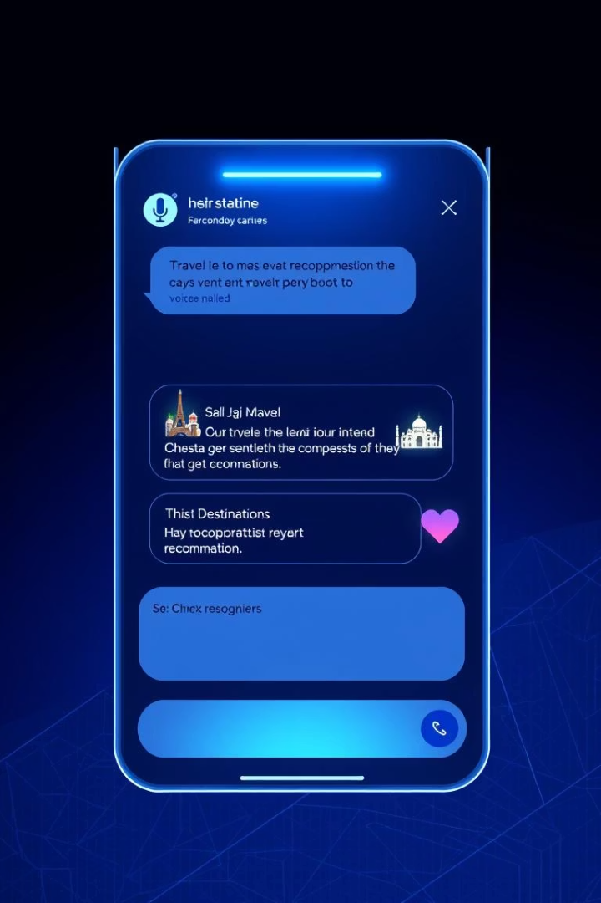



Future Enhancements
Voice Recognition
Enable voice-based interactions.
Sentiment Analysis
Understand customer emotions and tailor responses.
Personalized Recommendations
Offer relevant suggestions based on user preferences.

Slide 13
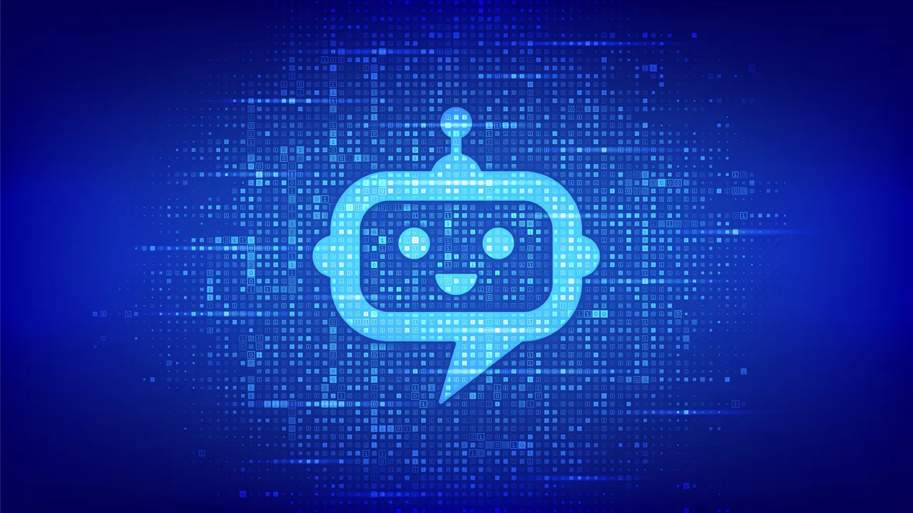
Conclusion
The chatbot project is a valuable investment in customer service and efficiency. We are confident that it will deliver significant benefits to our organization.This project gave us hands-on experience in deploying ML models as web services – from training data curation to production considerations like security and latency.

Slide 14
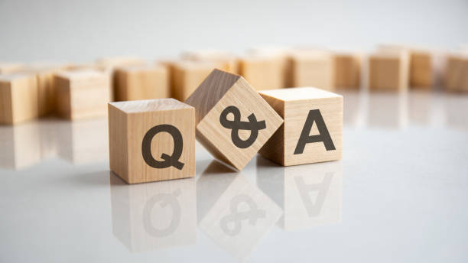

Slide 15
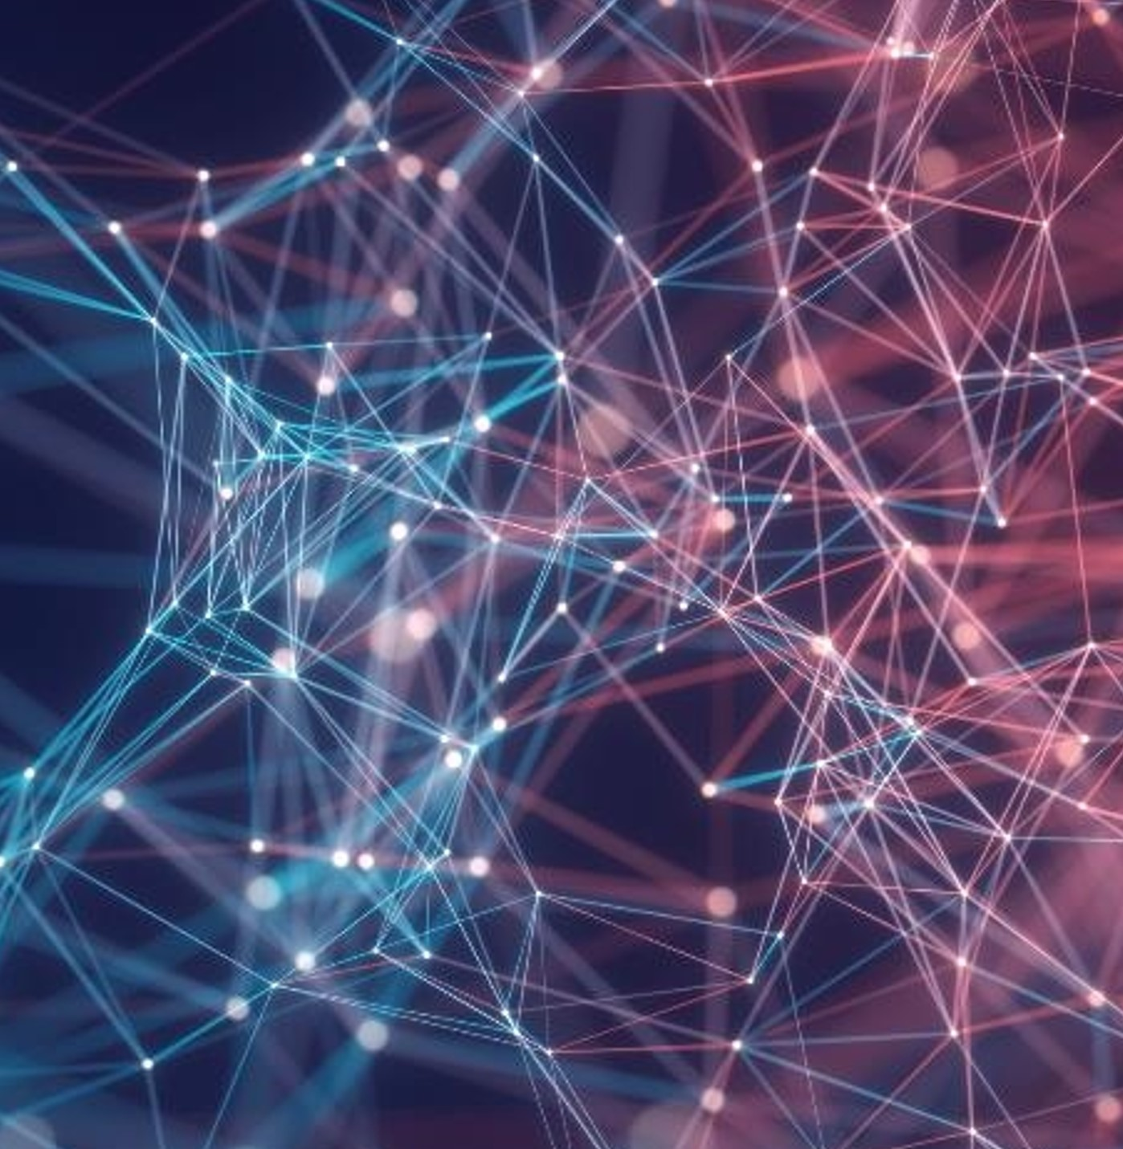
Thank you

